Slide 1
Artificial Intelligence (AI-2002)
Chapter 6: Constraint Satisfaction Problem

Slide 2
Objectives
Backtracking
MRV and degree heuristic
Forward checking
Improvement in forward check (through heuristic combination)
MAC (maintaining arc consistency)
Back jumping
Intelligent backtracking (constraint learning )

Slide 3
Constraint Satisfaction Problem
So far in Search space, states evaluated by heuristics and goal.
A constraint satisfaction problem (CSP) is a problem that requires its solution within some limitations/conditions also known as constraints.
For which the typical problems can be converted to CSP and solved.

Slide 4
Converting problems to CSPs
A problem to be converted to CSP requires the following steps:
Step 1: Create a variable set.(Representing state)
Step 2: Create a domain set.(values)
Step 3: Create a constraint set with variables and domains after considering the constraints.(limitations)

Slide 5
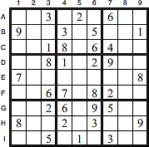
CSP Example1-Sudoku
Rule: Fill all empty Squares so that the numbers 1 to 9 appear once in each row, column and 3x3 box
VARIABLES – variables are cells (A1-I9)
DOMAIN – domain of each variable is
{1,2,3,4,5,6,7,8,9}
CONSTRAINT– constraints: rows, columns, boxes contain all different
numbers

Slide 6
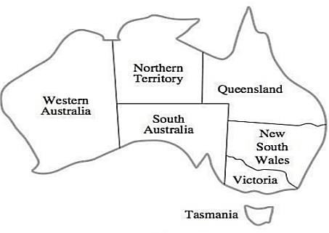
Example2-Map Coloring
Rule - Color each region either red, green or blue
- No adjacent region can have the same color

Slide 7
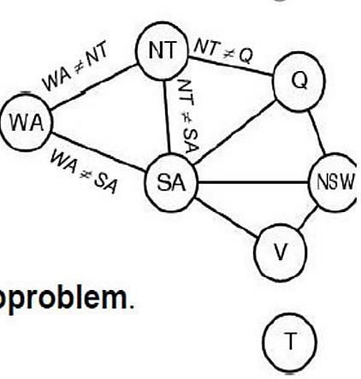

CSP Representation of Map Coloring
Variables: WA, NT, Q, NSW, V, SA, T
Domains: Di = {red, green, blue} Constraints: adjacent regions must have different colors
e.g., WA ≠ NT, or (WA,NT)
Constraint Graph
Nodes are Variables
Arcs are Constraint

Slide 8
Varieties of constraints
Unary constraints involve a single variable, e.g. SA ≠ green
Binary constraints involve pairs of variables (relates two variables),e.g., SA ≠ WA
Higher-order constraints involve 3 or more variables, e.g. cryptarithmetic puzzles (column constraints)

Slide 9
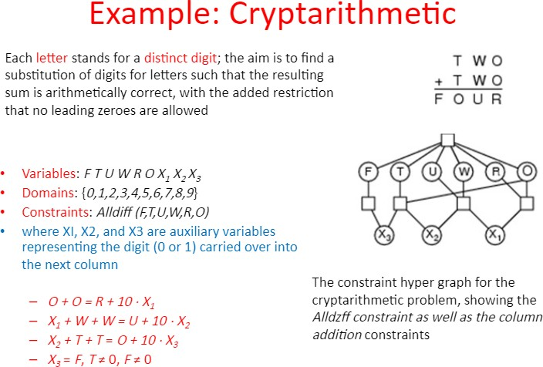

Slide 10
Backtracking search
Depth-first search for CSPs with single-variable assignments is called backtracking search
Variable assignments are commutative: [ WA = red then NT = green ] same as [ NT = green then WA = red ]
Only need to consider assignments to a single variable at each node
Backtracks when variable has no legal value

Slide 11
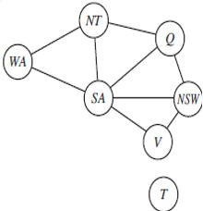
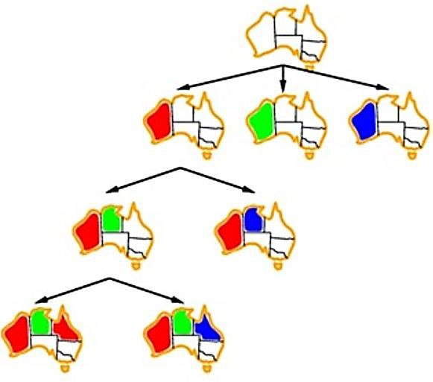
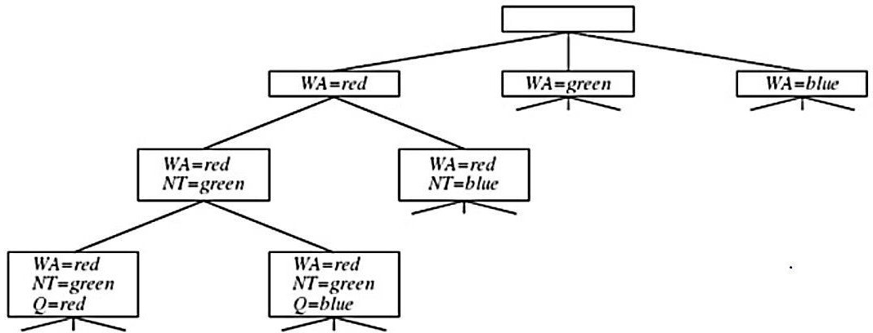

Backtracking for the map-coloring problem

Slide 12
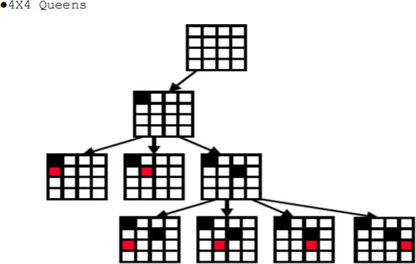
Backtracking Example:2

Slide 13
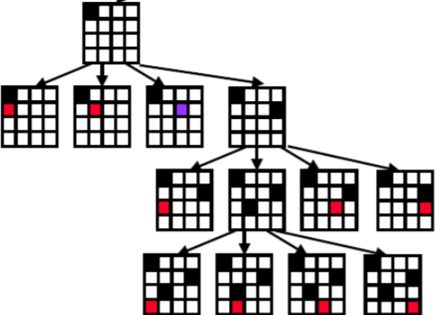

Slide 14
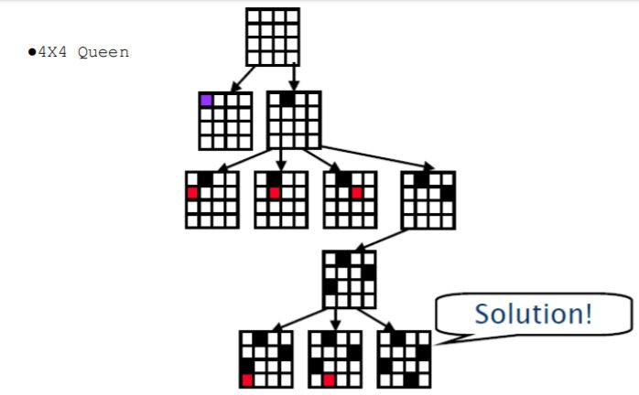

Slide 15
Improving backtracking efficiency (Variable and Value Ordering)
By default, Backtrack algorithm simply selects the next unassigned variable in the order given by the list VARIABLES[csp].
General-purpose methods can give huge gains in speed:
Which variable should be assigned next?
In what order should its values be tried ?
Can we detect inevitable failure early?

Slide 16
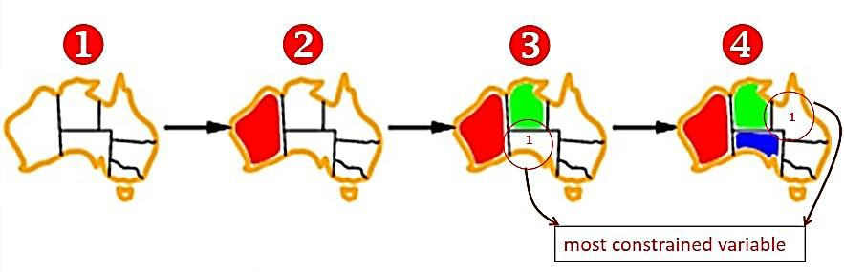
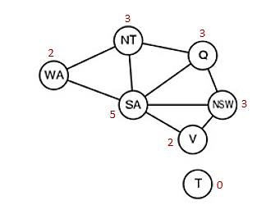
Minimum remaining values (MRV)
This intuitive idea-choosing the variable with the fewest "legal" values is called the minimum remaining values (MRV) heuristic (also known most constrained variable)
WA=(2)Red
NT(Remaining values)=2(Blue , Green)
while Q and NSW have 3 remaining values so, go for NT
SA( Remaining values)= 1(Blue)
after the assignments for WA = red and NT = green, there is only one possible value for SA, so it makes sense to assign SA = blue next rather than assigning Q, after SA is assigned, the choices for Q, NS W, and V are all forced.

Slide 17

Most-Constraining Variable (Degree Heuristics)
Most constraining variable: choose the variable with the most constraints on remaining variables
SA=5 (Most Constraints) BLUE
NT, Q, NSW = 3 TIE b/w them break it by choosing the
first choice either NT or NSW.
So, choose NT Then Q, NSW OR NSW, Then Q and NT

Slide 18
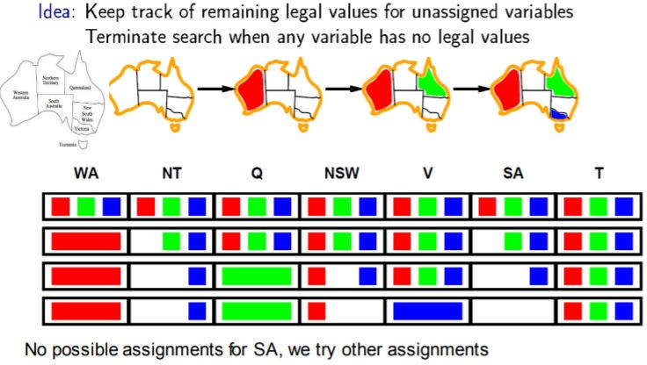
Forward Checking

Slide 19
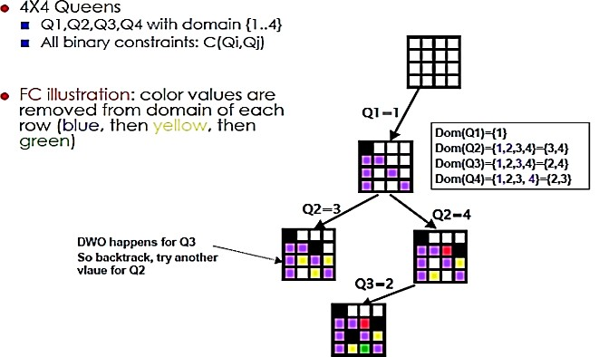
Forward Checking Example:2

Slide 20
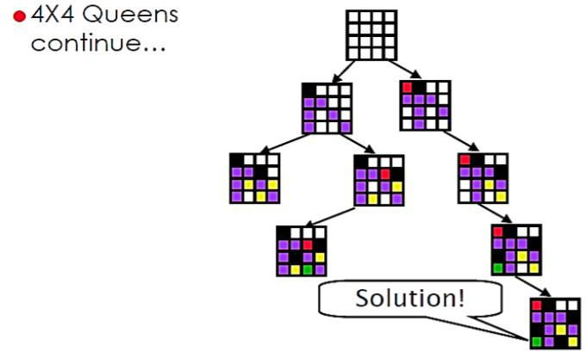
Forward Checking Example:2……

Slide 21
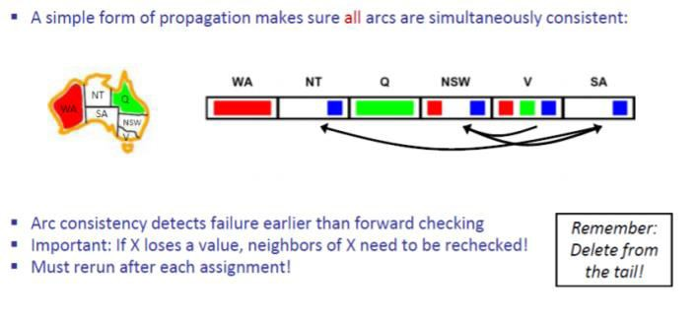
ARC Consistency

Slide 22
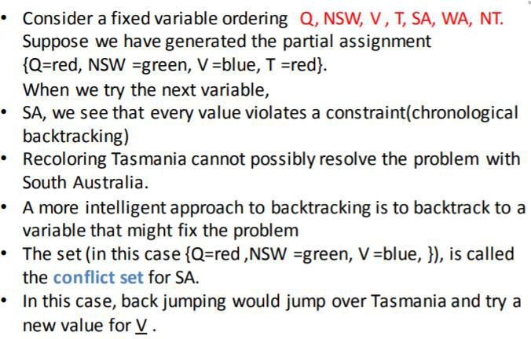
Intelligent Backtracking: Looking Backward

